Slide 1

Work Off Roadway
When workers or plant are present on site and if no part of the road shoulder , parking or auxiliary lane has been closed and the entire work area (including all vehicles and plant) is located at least three metres from the nearest edge of the lane carrying traffic:
  A Workers Symbolic (T1-5) sign in advance of work area; and
  A vehicle mounted warning device on each vehicle or item of plant.

Slide 2
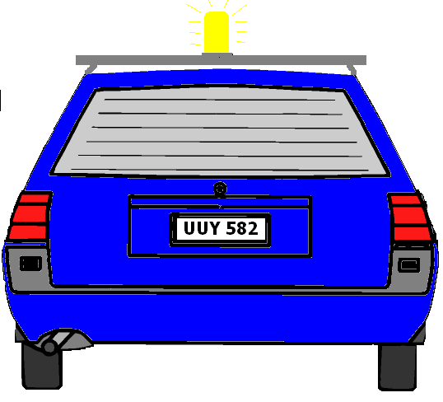

Or Road Shoulder
3 metres
Parking or Auxiliary Lane
Median Strip
Parking or Auxiliary Lane
MULTI- LANE DIVIDED ROAD

Slide 3
Or Road Shoulder
3 metres
Parking or Auxiliary Lane
Parking or Auxiliary Lane
TWO LANE TWO WAY ROAD

Slide 4
Work Off Roadway
If there is a partial closure of the roadway, road shoulder, parking lane or auxiliary lane but the work area is a minimum of 3 metres from the nearest edge of the lane carrying traffic, all signs and delineation devices shall be used.

Slide 5



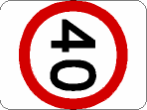
300-400m
160m
WORK AREA
50m
Road Shoulder
Parking or Auxiliary Lane
3 metres
Median Strip
Parking or Auxiliary Lane
MULTI- LANE DIVIDED ROAD

Slide 6


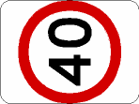
300-400m
160m
WORK AREA
160m
300-400m
Parking or Auxiliary Lane
Road Shoulder
3 metres
Parking or Auxiliary Lane
TWO LANE TWO WAY ROAD

Slide 7
Frequently Changing Work Areas
For activities where the work area is continually progressing along a route (such activities include minor pavement maintenance, shoulder grading and the mowing of medians) then under appropriate conditions, advanced warning signs may be placed up to 2 km in advance of the work
Work may then progress along the road until the advance sign is a maximum of 2 km behind at which point advance signs at both ends of the job should be relocated.

Slide 8




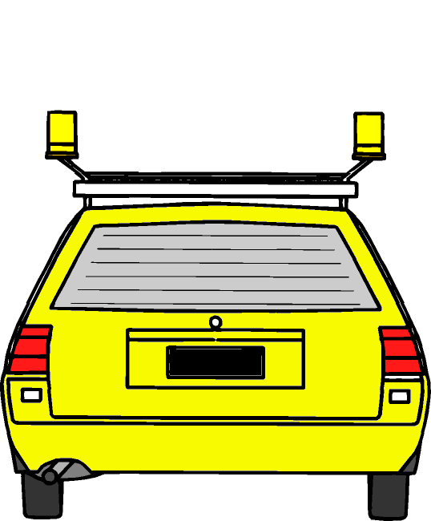
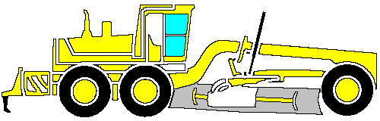
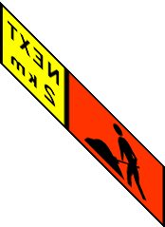


200m
or
or
Work limit
Not more than 2 km
200m
or
Work limit
or
or

